Slide 1
Planning in the Continuous Domain: a Generalized
Belief Space Approach for Autonomous Navigation in
Unknown Environments
Vadim Indelman, Luca Carlone , and Frank Dellaert
International Journal of Robotics Research - 2015
Indelman, V., Carlone, L., and Dellaert, F. (2013). Towards planning in generalized belief space. In Proc. of the Intl. Symp. of Robotics Research (ISRR).
Indelman, V., Carlone, L., and Dellaert, F. (2014). Planning under uncertainty in the continuous domain: a generalized belief space approach. In IEEE Intl. Conf. on Robotics and Automation (ICRA).
Dan and Alon

Slide 2
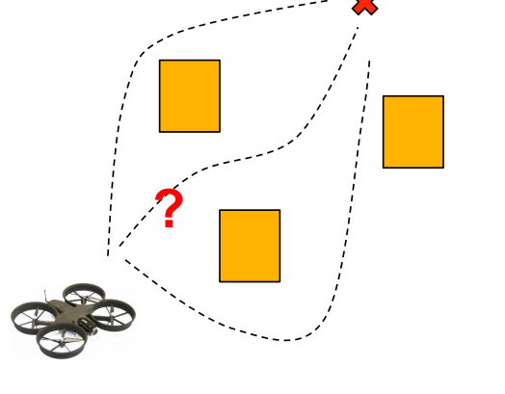
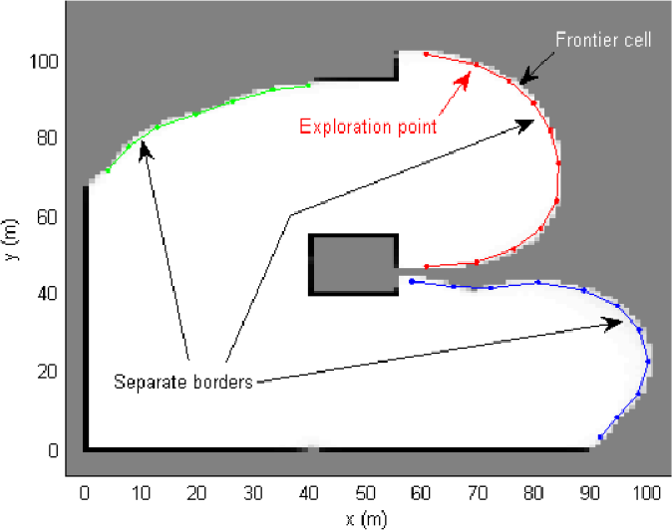
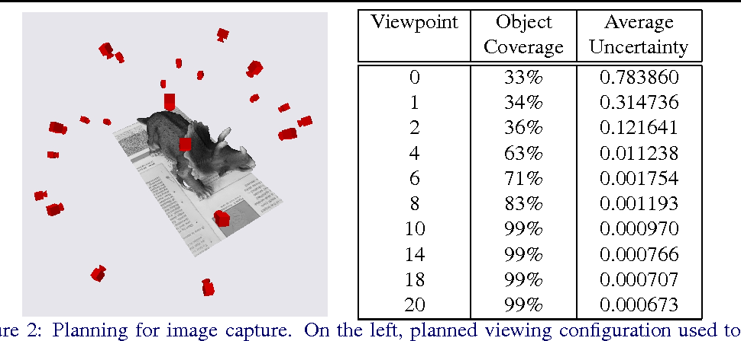
Problem Statement
Formulate a general strategy to accomplish common tasks in robotics in the following setting:
No prior knowledge
Continuous Domain (as opposed to discrete)
Maximum Likelihood Observations
Path Planning
Exploration
Next Best View

Slide 3
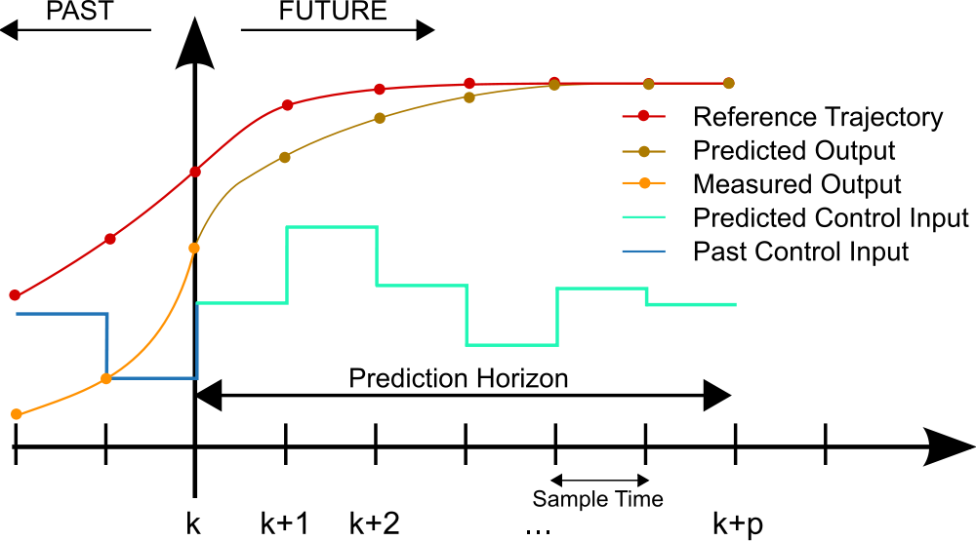
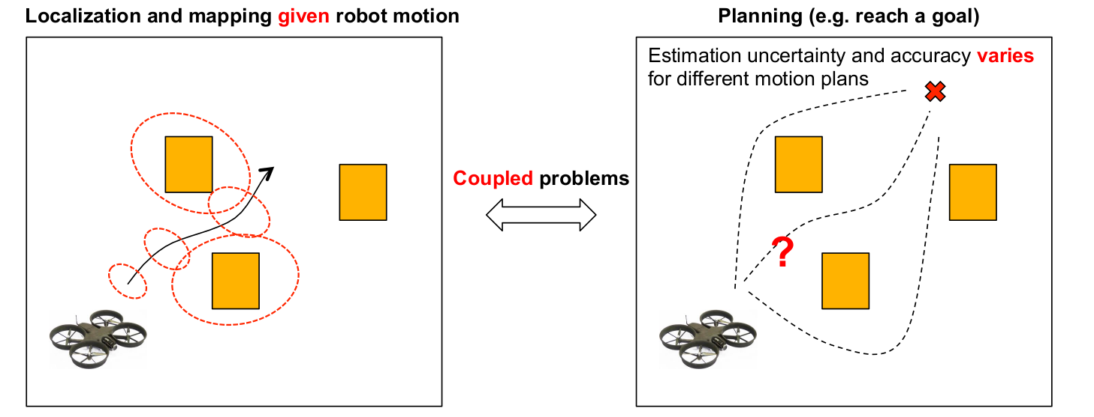
Approach:
Model Predictive Controller
Plan with the Estimation in mind

Slide 4
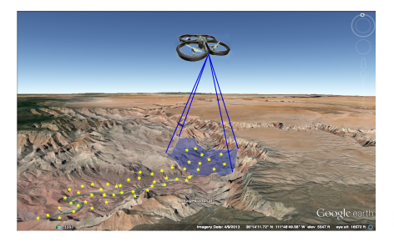
Motivating Example Used:
UAV flies over an unknown region with a camera looking downwards.
Its goal is to reach pre-specified goal positions while preserving an acceptable localization error
Notes:
UAV in an unknown

Slide 5
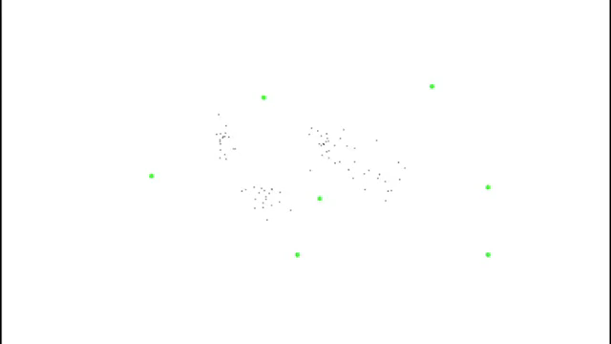

Slide 6
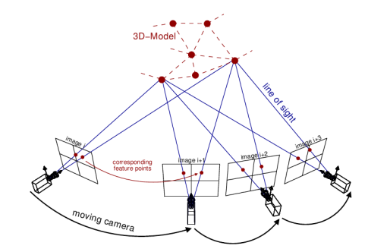
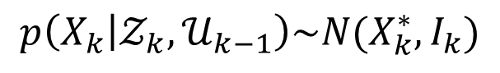
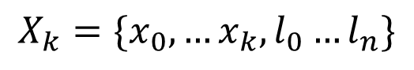
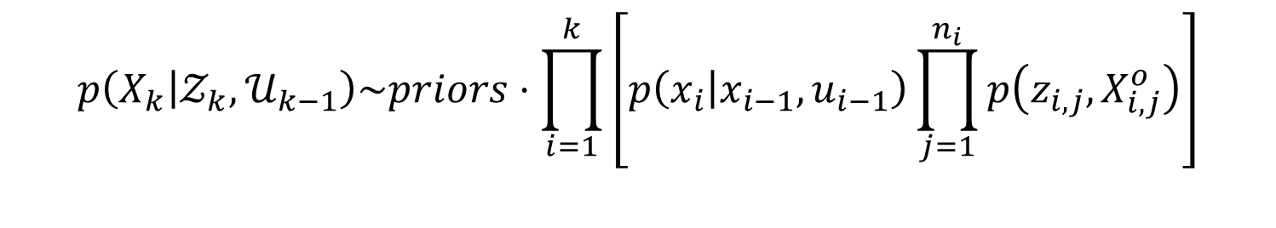
Plan with Estimation in Mind:
As the environment is unknown, a joint state vector is held:
$$X_{k}=\{x_{0},…x_{k},l_{0}…l_{n}\}$$
robot poses
landmarks
Estimation over the joint probability:
$$p\left(X_{k} | 𝒵_{k},𝒰_{k−1}\right)\sim priors⋅\prod_{i=1}^{k}{\left[p\left(x_{i} | x_{i−1},u_{i−1}\right)\prod_{j=1}^{n_{i}}{p\left(z_{i,j},X_{i,j}^{o}\right)}\right]}$$
Motion model
Observation model
Architect models such that the posterior can be modeled as a gaussian:
$$p\left(X_{k} | 𝒵_{k},𝒰_{k−1}\right)\sim N(X_{k}^{∗},I_{k})$$
Information Matrix

Slide 7
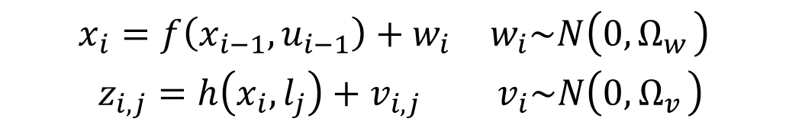
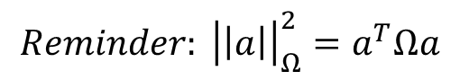
Solving for the posterior distribution via Expectation Maximization:
$$X_{k}^{∗}=\underset{X_{k}}{argmax} p\left(X_{k} | 𝒵_{k},𝒰_{k−1}\right)=\underset{X_{k}}{argmin}\left\{−\log\left(p\left(X_{k} | 𝒵_{k},𝒰_{k−1}\right)\right)\right\}$$
$$\begin{matrix}x_{i}=f\left(x_{i−1},u_{i−1}\right)+w_{i} & w_{i}\sim N\left(0,Ω_{w_{ }}\right) \\ z_{i,j}=h\left(x_{i},l_{j}\right)+v_{i,j} & v_{i}\sim N\left(0,Ω_{v_{ }}\right)\end{matrix}$$
$$X_{K}^{∗}=\underset{X_{k}}{argmin} \left\{{\left|\left|x−{\hat{x}}_{0}\right|\right|}_{Ω_{0}}^{2}+\sum_{i}{\left[{\left|\left|x_{i}−f\left(x_{i−1},u_{i−1}\right)\right|\right|}_{{Ω_{w}}_{i}}^{2}+\sum_{j=ℳ_{i}}{{\left|\left|z_{i,j}−h\left(x_{i},l_{j}\right)\right|\right|}_{{Ω_{v}}_{i,j}}^{2}}\right] }\right\}$$
Prior
Motion Models
Observation models
$$Reminder: {\left|\left|a\right|\right|}_{Ω}^{2}=a^{T}Ωa$$

Slide 8

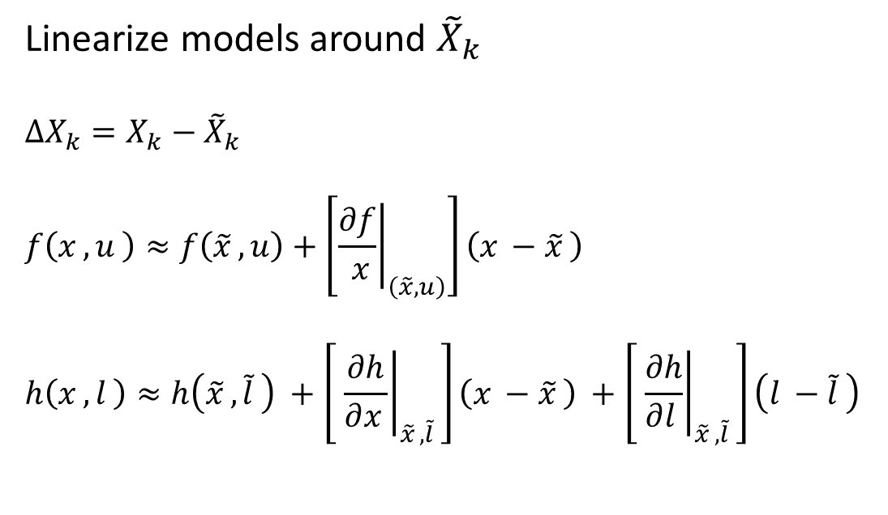
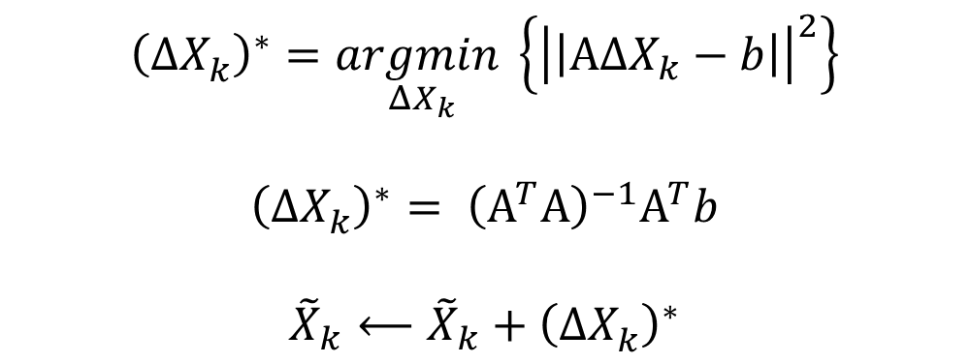
Solving for the posterior distribution via Expectation Maximization:
$$X_{K}^{∗}=\underset{X_{k}}{argmin} \left\{{\left|\left|x−{\hat{x}}_{0}\right|\right|}_{Ω_{0}}^{2}+\sum_{i}{\left[{\left|\left|x_{i}−f\left(x_{i−1},u_{i−1}\right)\right|\right|}_{{Ω_{w}}_{i}}^{2}+\sum_{j=ℳ_{i}}{{\left|\left|z_{i,j}−h\left(x_{i},l_{j}\right)\right|\right|}_{{Ω_{v}}_{i,j}}^{2}}\right] }\right\}$$
Linearize models around ${\tilde{X}}_{k}$
$$ΔX_{k}=X_{k}−{\tilde{X}}_{k}$$
$$f\left(x_{ },u_{ }\right)≈f\left({\tilde{x}}_{ },u\right)+\left[{\left.\frac{∂f}{ x}\right|}_{\left(\tilde{x}, u\right)}\right]\left(x_{ }−{\tilde{x}}_{ }\right)$$
$$h\left(x_{ },l_{ }\right)≈h\left({\tilde{x}}_{ },{\tilde{l}}_{ }\right) +\left[ {\left.\frac{∂h}{∂x_{ }}\right|}_{{\tilde{x}}_{ },{\tilde{l}}_{ }}\right]\left(x_{ }−{\tilde{x}}_{ }\right) +\left[ {\left.\frac{∂h}{∂l_{ }}\right|}_{{\tilde{x}}_{ },{\tilde{l}}_{ }}\right]\left(l_{ }−{\tilde{l}}_{ }\right)$$
$${\left(ΔX_{k}^{ }\right)}^{∗}=\underset{ΔX_{k}}{argmin}\left\{{\left|\left|ΑΔX_{k}−b\right|\right|}^{2}\right\}$$
$${\left(ΔX_{k}^{ }\right)}^{∗}= {\left(Α^{T}Α\right)}^{−1}Α^{T}b$$
$${\tilde{X}}_{k}⟵{\tilde{X}}_{k}+{\left(ΔX_{k}^{ }\right)}^{∗}$$
Do this until convergence

Slide 9
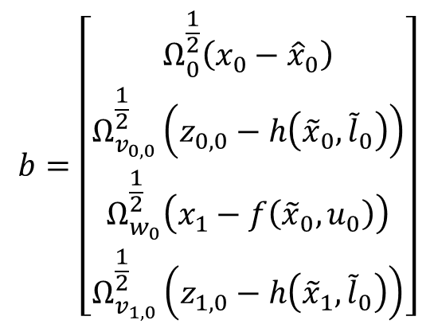
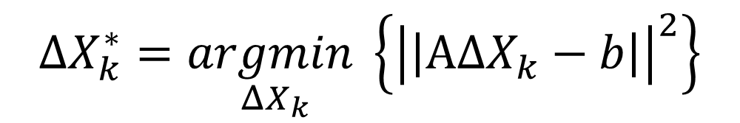
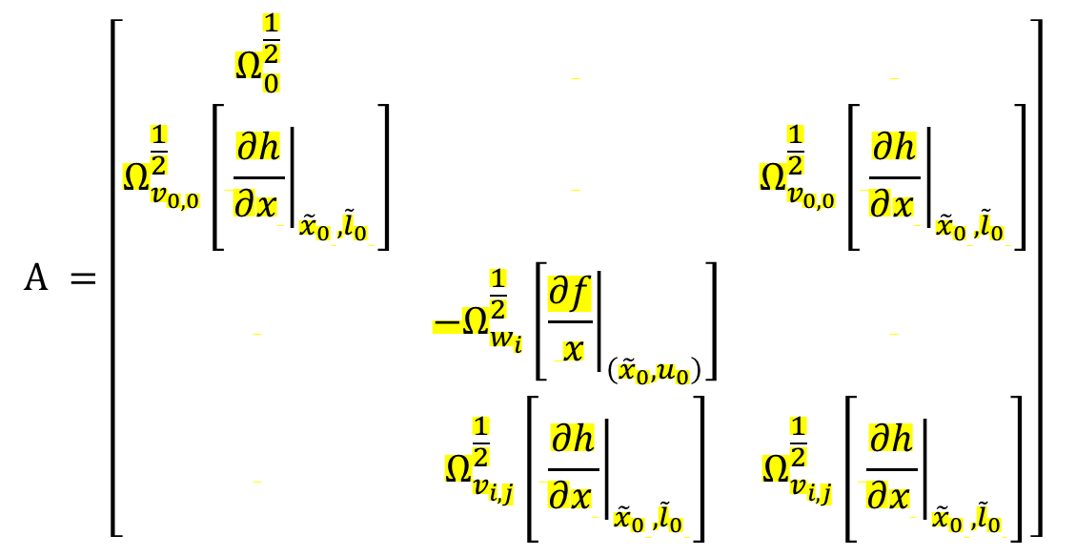
Solving for the posterior distribution via Expectation Maximization:
$$ΔX_{k}^{∗}=\underset{ΔX_{k}}{argmin}\left\{{\left|\left|ΑΔX_{k}−b\right|\right|}^{2}\right\}$$
$$Α =\left[\begin{matrix}Ω_{0}^{\frac{1}{2}} & & \\ Ω_{v_{0,0}}^{\frac{1}{2}}\left[ {\left.\frac{∂h}{∂x_{ }}\right|}_{{{\tilde{x}}_{0}}_{ },{{\tilde{l}}_{0}}_{ }}\right] & & Ω_{v_{0,0}}^{\frac{1}{2}}\left[ {\left.\frac{∂h}{∂x_{ }}\right|}_{{{\tilde{x}}_{0}}_{ },{{\tilde{l}}_{0}}_{ }}\right] \\ & −Ω_{w_{i}}^{\frac{1}{2}}\left[{\left.\frac{∂f}{ x}\right|}_{\left({\tilde{x}}_{0}, u_{0}\right)}\right] & \\ & Ω_{v_{i,j}}^{\frac{1}{2}}\left[ {\left.\frac{∂h}{∂x_{ }}\right|}_{{{\tilde{x}}_{0}}_{ },{{\tilde{l}}_{0}}_{ }}\right] & Ω_{v_{i,j}}^{\frac{1}{2}}\left[ {\left.\frac{∂h}{∂x_{ }}\right|}_{{{\tilde{x}}_{0}}_{ },{{\tilde{l}}_{0}}_{ }}\right]\end{matrix}\right]$$
$$b=\left[\begin{matrix}Ω_{0}^{\frac{1}{2}}\left(x_{0}−{\hat{x}}_{0}\right) \\ Ω_{v_{0,0}}^{\frac{1}{2}}\left(z_{0,0}−h\left({\tilde{x}}_{0},{\tilde{l}}_{0}\right)\right) \\ Ω_{w_{0}}^{\frac{1}{2}}\left(x_{1}−f\left({\tilde{x}}_{0},u_{0}\right)\right) \\ Ω_{v_{1,0}}^{\frac{1}{2}}\left(z_{1,0}−h\left({\tilde{x}}_{1},{\tilde{l}}_{0}\right)\right)\end{matrix}\right]$$
Whitened errors
Whitened Jacobians
Not a function of the measurements (at first iteration)

Slide 10
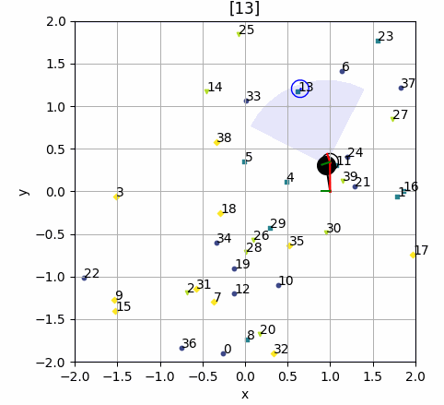
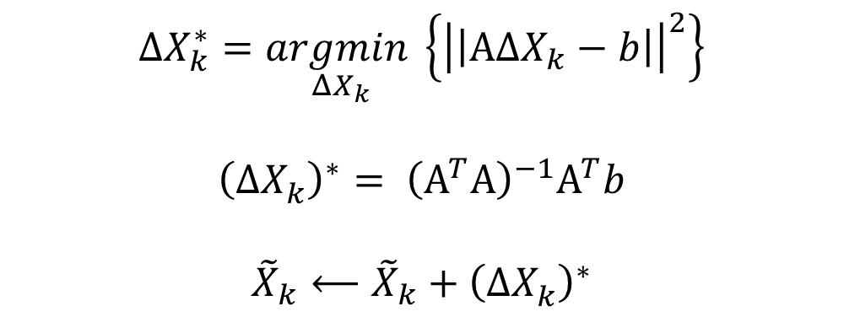
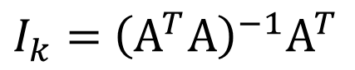
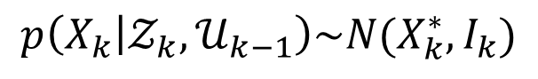
Solving for the posterior distribution via Expectation Maximization:
$$p\left(X_{k} | 𝒵_{k},𝒰_{k−1}\right)\sim N(X_{k}^{∗},I_{k})$$
$$ΔX_{k}^{∗}=\underset{ΔX_{k}}{argmin}\left\{{\left|\left|ΑΔX_{k}−b\right|\right|}^{2}\right\}$$
$${\left(ΔX_{k}^{ }\right)}^{∗}= {\left(Α^{T}Α\right)}^{−1}Α^{T}b$$
$${\tilde{X}}_{k}⟵{\tilde{X}}_{k}+{\left(ΔX_{k}^{ }\right)}^{∗}$$
$I_{k}=$ ${\left(Α^{T}Α\right)}^{−1}Α^{T}$
Do this until convergence

Slide 11
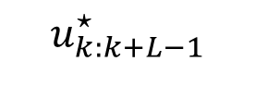
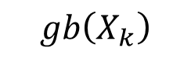
Planning in the Generalized Belief Space
$$gb\left(X_{k}\right)$$
Estimate of future state
$$u_{k:k+L−1}^{⋆}$$
$$gb\left(X_{k}\right)= p\left(X_{k} | 𝒵_{k},𝒰_{k−1}\right)\sim N(X_{k}^{∗},I_{k})$$

Slide 12
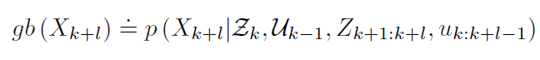
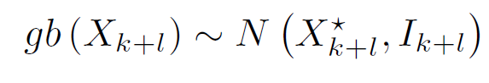
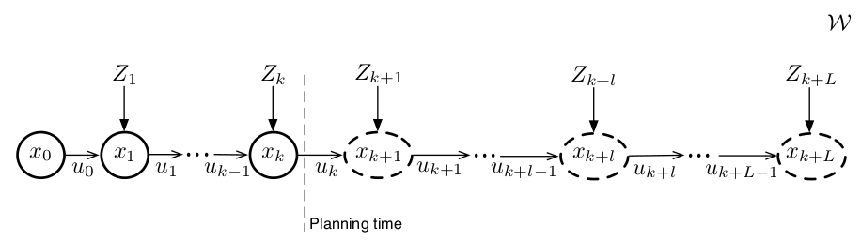
Planning in the Generalized Belief Space
Past
Future

Slide 13
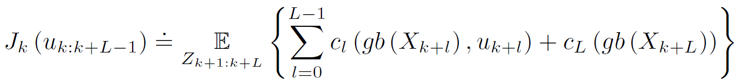

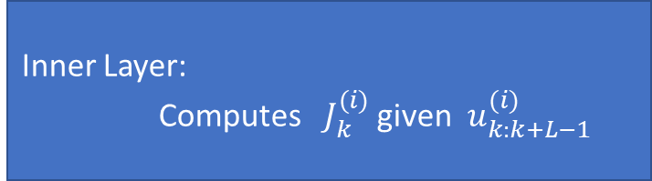
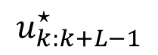
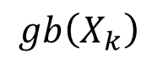
Planning in the Generalized Belief Space
Outer Layer: Updates $u_{k:k+L−1}^{(i+1)}$ given $J_{k}^{(i)}$
Inner Layer:
Computes $J_{k}^{(i)}$ given $u_{k:k+L−1}^{(i)}$
$$u_{k:k+L−1}^{⋆}$$
$$gb\left(X_{k}\right)$$

Slide 14
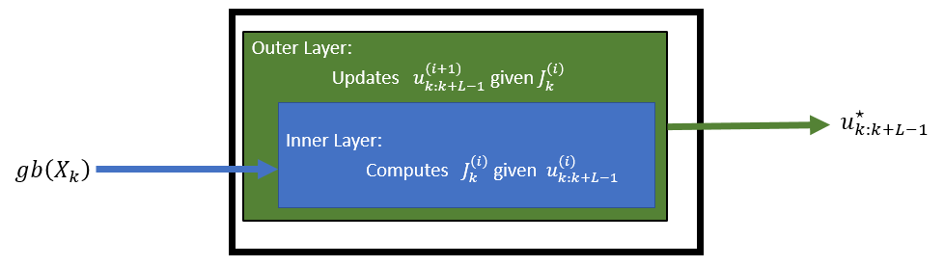
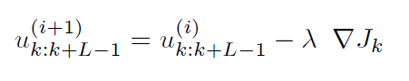

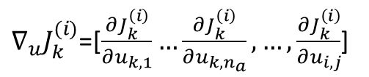
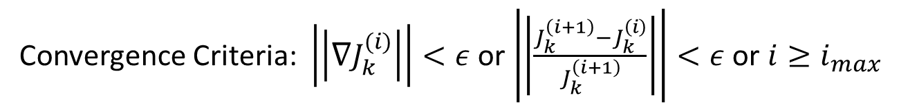

Outer Layer – Inference over the control
Updating via Gradient Decent:
$∇J_{k}$- is the gradient of the objective function
$λ$– suitable step size (positive value)
Convergence Criteria: $\left|\left|∇J_{k}^{(i)}\right|\right|<ε$ or $\left|\left|\frac{J_{k}^{\left(i+1\right)}−J_{k}^{\left(i\right)}}{J_{k}^{\left(i+1\right)}}\right|\right|<ε$ or $i≥i_{max}$
$$\frac{{∂J}_{k}^{\left(i\right)}}{∂u_{i,j}}≈\frac{J_{k}^{i}\left(u+εe_{i,j}\right)−J_{k}^{i}\left(u\right)}{ε}$$
$∇_{u}J_{k}^{(i)}$=[$\frac{{∂J}_{k}^{\left(i\right)}}{∂u_{k,1}}…\frac{{∂J}_{k}^{\left(i\right)}}{∂u_{k,n_{a}}},…,\frac{{∂J}_{k}^{\left(i\right)}}{∂u_{i,j}}$]
Notes:
(1) The control update is preformed in a continuous domain and can be realized using different optimization techniques. In the paper the method that used is a simple gradient method to compute $u_{k:k+L−1}^{⋆}$.

Slide 15
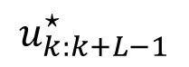
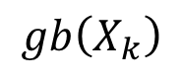

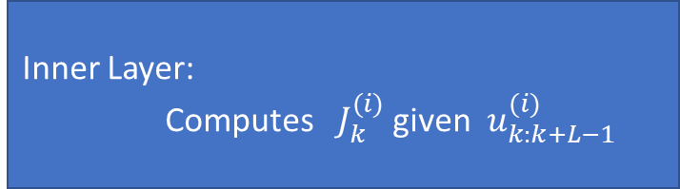
Planning in the Generalized Belief Space
Outer Layer: Updates $u_{k:k+L−1}^{(i+1)}$ given $J_{k}^{(i)}$
Inner Layer:
Computes $J_{k}^{(i)}$ given $u_{k:k+L−1}^{(i)}$
$$u_{k:k+L−1}^{⋆}$$
$$gb\left(X_{k}\right)$$

Slide 16
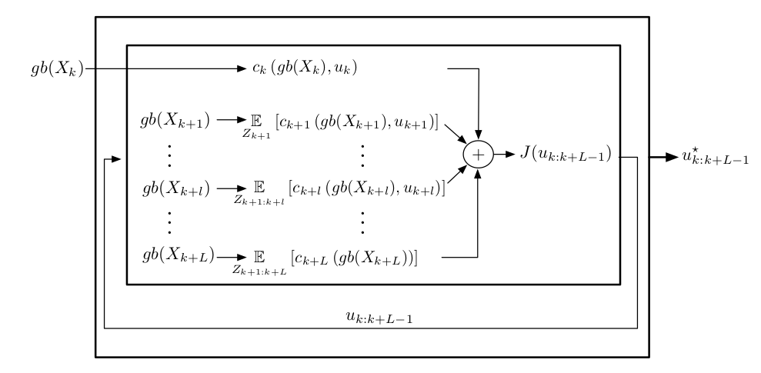
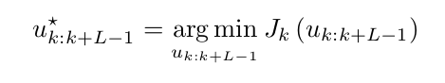
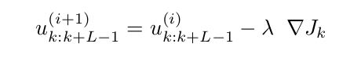

Slide 17
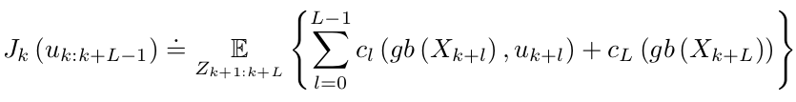
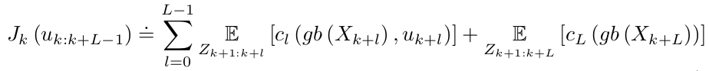

Slide 19
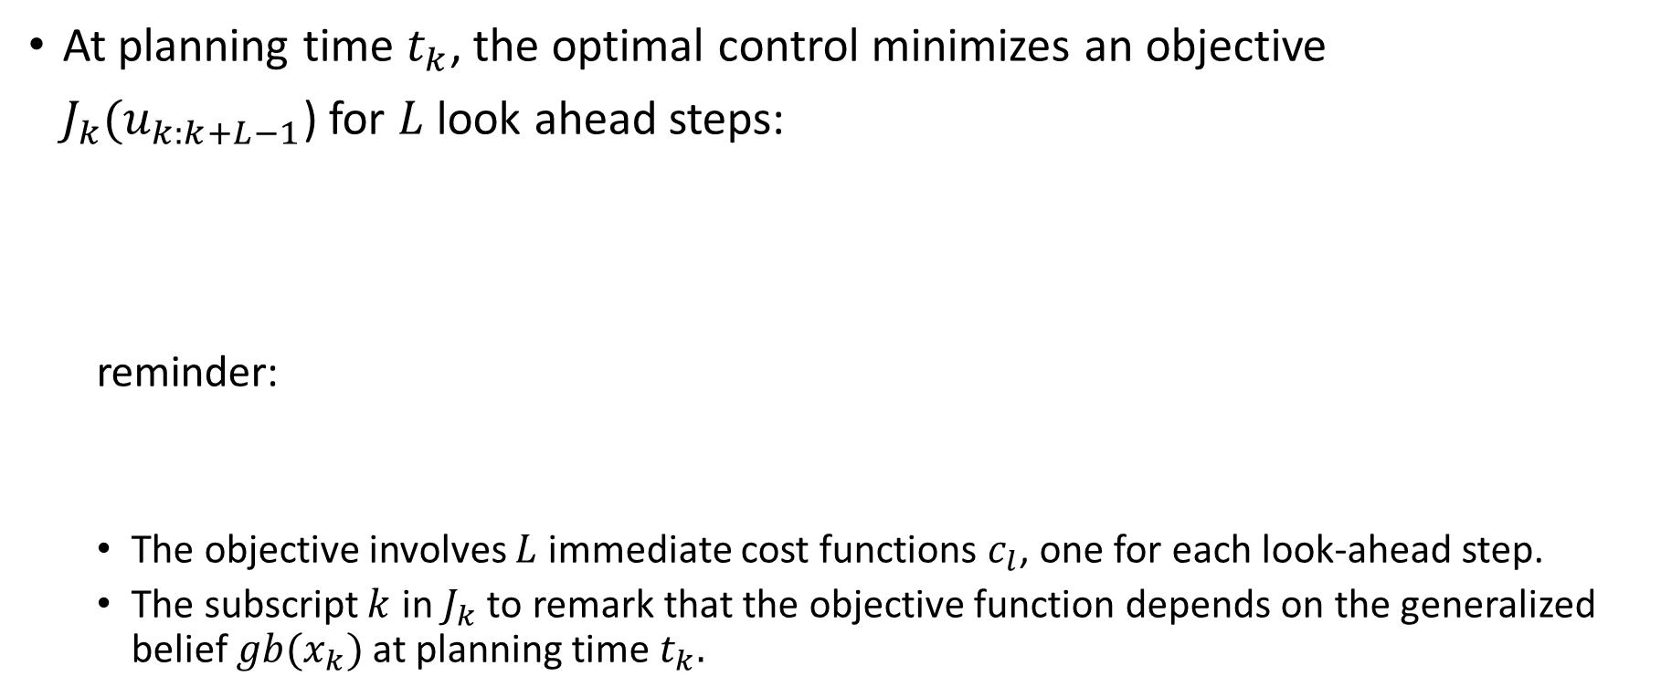
Planning in the GBS
At planning time $t_{k}$, the optimal control minimizes an objective
$J_{k}(u_{k:k+L−1}$) for $L$ look ahead steps:
reminder:
The objective involves $L$immediate cost functions $c_{l}$, one for each look-ahead step.
The subscript $k$ in $J_{k}$ to remark that the objective function depends on the generalized belief $gb(x_{k})$ at planning time $t_{k}.$

Slide 20
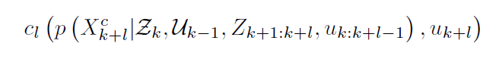
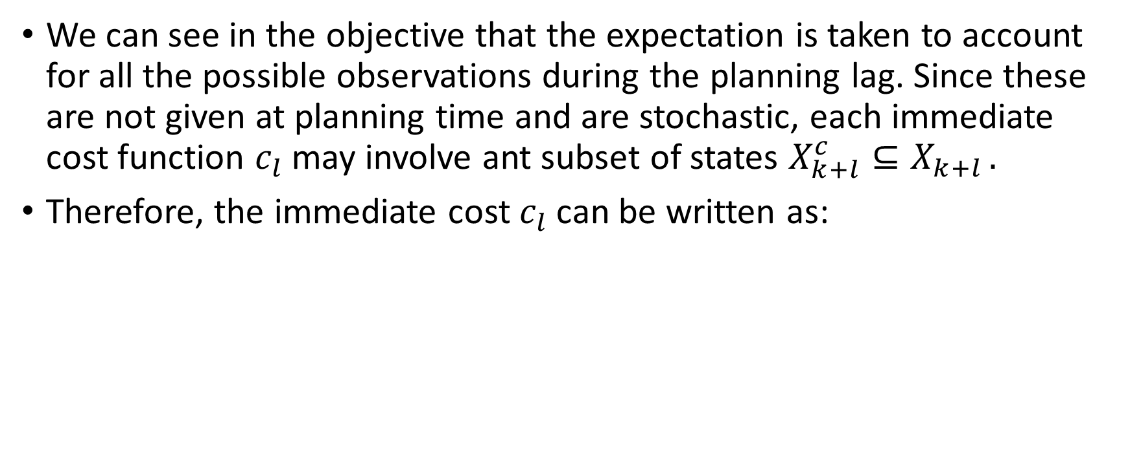
Planning in the GBS
We can see in the objective that the expectation is taken to account for all the possible observations during the planning lag. Since these are not given at planning time and are stochastic, each immediate cost function $c_{l}$ may involve ant subset of states $X_{k+l}^{c}⊆X_{k+l }.$
Therefore, the immediate cost $c_{l}$ can be written as:

Slide 21
Planning in the GBS
The expectation is a linear operator so we can rewrite the objective function as:
In order to optimize the objective function ,as written in the paper, we resort to an iterative optimization approach, starting from known initial guess on the controls.

Slide 22
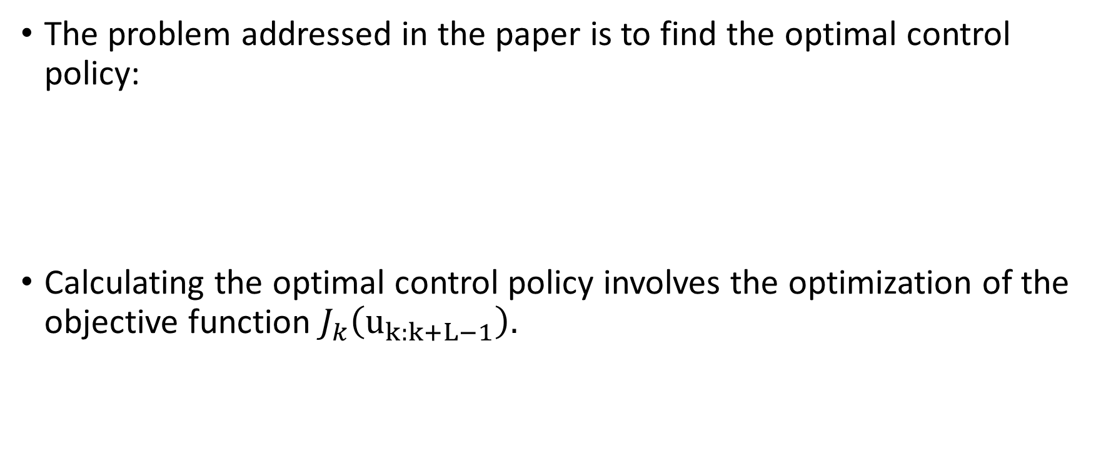
Planning in the GBS
The problem addressed in the paper is to find the optimal control policy:
Calculating the optimal control policy involves the optimization of the objective function $J_{k}\left(u_{k:k+L−1}\right).$

Slide 23
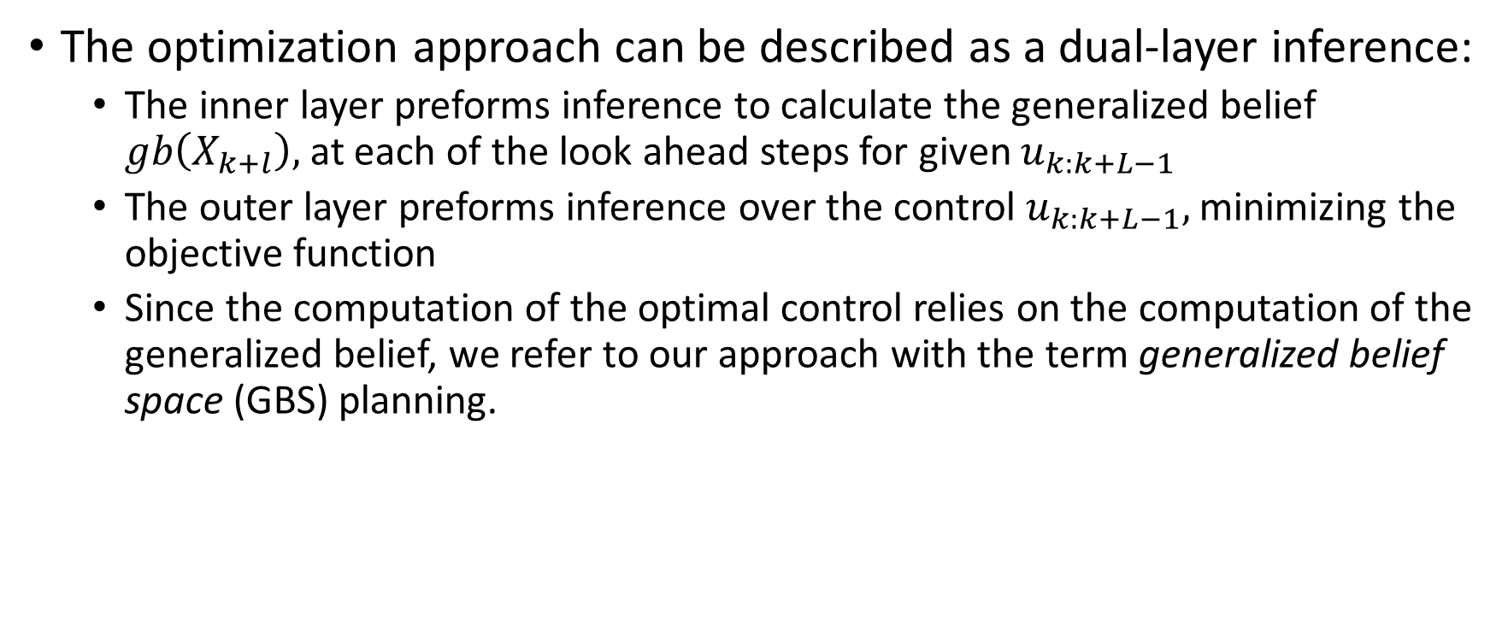
Planning in the GBS
The optimization approach can be described as a dual-layer inference:
The inner layer preforms inference to calculate the generalized belief $gb\left(X_{k+l}\right),$at each of the look ahead steps for given $u_{k:k+L−1}$
The outer layer preforms inference over the control $u_{k:k+L−1},$ minimizing the objective function
Since the computation of the optimal control relies on the computation of the generalized belief, we refer to our approach with the term generalized belief space (GBS) planning.

Slide 25
Outer Layer: Inference over the control
Planning in the GBS

Slide 26
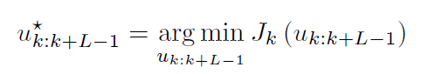
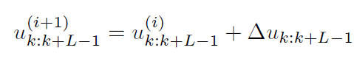

Planning in the GBS
Outer Layer: Inference over the control
In order to finding a locally-optimal control policy $u_{k:k+L−1}^{⋆}$ corresponds to minimizing the general objective function:
The outer layer is an iterative optimization over the non- linear objective function $J_{k}\left(u_{k:k+L−1}\right).$ Like we mentioned in the optimization starts from a nominal control $u_{k:k+L−1}^{0},$ and at each iteration, computes the delta vector $Δu_{k:k+L−1}$ that is used to update the current values of the controls:

Slide 27

Outer Layer: Inference over the control
Planning in the GBS
The control update is preformed in a continuous domain and can be realized using different optimization techniques. In the paper the method that used is a simple gradient method to compute $u_{k:k+L−1}^{⋆}$.
Gradient Descent Method: At each i-th iteration of this method the current control is updated as follows:
Where:
$∇J_{k}$- is the gradient of the objective function
$λ$– suitable step size (positive value)
The iterations terminate when a suitable stopping condition is reached.
One common stopping condition are based on the norm of the $∇J_{k}$
(the gradient become zero at minimum).

Slide 28

Outer Layer: Inference over the control
Planning in the GBS
upon convergence the gradient method provides the optimal control policy $u_{k:k+L−1}^{⋆}$ for $L$ look-ahead steps.
according to the standard model predictive control framework at each time the agent solve the optimization problem and only applies the first command $u_{k}^{⋆}$ extracted from the computed policy $u_{k:k+L−1}^{⋆}$

Slide 29
Inner Layer: Inference in GBS
Planning in the GBS

Slide 30



Inner Layer: Inference in GBS
Planning in the GBS
The inner layer involve the computation of the Gaussian approximation of:
Whose mean value coincides with the MAP estimate of:
Number of complications arising when trying to solve the $argmin$ problem:
Unknown if observation $z_{k+l,j}$ will be obtained
Even if we have an observation we cannot know a-priori what the future measurement $z_{i,j}$ will be

Slide 31


Inner Layer: Inference in GBS
Planning in the GBS
The complications lead to definition of 2 new random variables:
1. $z_{i,j}$ - observation at time $i$ of the $j$th landmark
2. $γ_{i,j}$ - $binary$random variable for each observation (acquired or not acquired)
$z_{i,j}$ and $γ_{i,j}$ lead to a new joint probability density:
Noted that $Γ_{i}≐{\left\{γ_{i,j}\right\}}_{j=1}^{n_{i}}$ being the number of possible observations at time $t_{i}.$
Using chain rule, we can write the joint probability as:
Notes:
1.In our mobile robotics example, $n_{i}$ is simply the number of landmarks
observed thus far

Slide 32


Inner Layer: Inference in GBS
Planning in the GBS
The complications lead to definition of 2 new random variables:
1. $z_{i,j}$ - observation at time $i$ of the $j$th landmark
2. $γ_{i,j}$ - $binary$random variable for each observation (acquired or not acquired)
$z_{i,j}$ and $γ_{i,j}$ lead to a new joint probability density:
Noted that $Γ_{i}≐{\left\{γ_{i,j}\right\}}_{j=1}^{n_{i}}$ being the number of possible observations at time $t_{i}.$
Using chain rule, we can write the joint probability as:
Using the assumption that the prior is un-informative we can write the probability as:
Notes:
1. We now take the assumption that the prior $p (Z_{k+1:k+l}|Z_{k}, U_{k−1, uk:k+l−1})$is uninformative.
This assumption is fairly standard in inference, see, e.g., Eq. (2.55)
in (Thrun et al., 2005)).

Slide 33


Inner Layer: Inference in GBS
Planning in the GBS
We want to compute the belief $gb\left(x_{k+l}\right)$ which defined only over the states, we marginalize the random variables $Γ_{k+1:k+l}$ and get:
Although the expression above can be used to compute the MAP estimator, there are 2 issues are still on the way:
1. Marginalize $Γ_{k+1:k+l}$ is intractable is general
2. The predicted belief $gb\left(x_{k+l}\right)$ is a function of $Z_{k+1:k+l}$which are unknown at planning time
Therefore, rater than computing a single vector representing the MAP estimate, here the objective is to compute a vector-valued function of $Z_{k+1:k+l}$ which gives the MAP estimate for each possible value of $Z_{k+1:k+l}$.
The paper solve these two complications exploiting with two tools, expectation-maximization and Gauss-Newton approach.
Notes:
1.

Slide 34

Inner Layer: Inference in GBS
Planning in the GBS
According to the expectation-maximization (EM) approach instead of minimizing directly the probability which requires to marginalize $Γ_{k+1:k+l},$ we minimize the following:
Where the expectation is computed assuming a given nominal state ${\overline{X}}_{k+l}.$
Notes:
1.

Slide 35

Planning in the GBS
Illustration of the dual-layer inference planning approach:

Slide 36

Outer Layer: Inference over the control
Planning in the GBS
Gradient descent simulation

Slide 37

Objective functions
The exposition thus far has been given for general immediate cost function
Now when taking about the state $X_{k}$ its include the robot trajectory (collection of poses), and 3D positions of landmarks in the environment
In the paper the agent is a UAV and in each time step there are three main objectives:
Reach a given goal position $X^{G}$
Keep its position estimate uncertainty below a given bound $β$
Has to minimize control usage

Slide 38


Objective functions
According to the requirements in the last slide the paper design the following family of immediate costs:
where:
1. $M_{Σ},M_{u} and M_{x}$ are wight matrices
2. $ζ\left(u\right)$ is some known function that, depending on the application, quantifies the usage of control $u$

Slide 39


Objective functions
Reminder that our general objective function form is:
Plugging the 2 equations from the previews slide into the objective form we get:
Denote that the expectation removed from the first and the second summand as they do not depend on $Z_{k+1:k+L}.$

Slide 40

Objective functions
After computing the expectation in the last summand in the objective function in the previews slide, the objective function get the form:
Where the term (a) contains term penalizing control usage; the term (b) contains terms penalizing uncertainty, and the term (c) represents the expected inventive in reaching the goal.

Slide 41


Objective functions
Implementation Details
In the final objective term, we saw that we have three weight matrices $M_{Σ},M_{u} and M_{x},$ and now we will discuss how to properly choose them.
Choice of $M_{u}:$This matrix has a very intuitive function. A large $M_{u}$ induces more conservative policies that penalize large controls. In the paper scenario, the control usage $ζ(u)$ quantifies the change in the yaw angle;, which is used by the UAV to control the direction of its motion. In the demonstrated Figure, from the paper below, we can see that higher values of $M_{u}$ lead to smoother movement (apply smaller force to change the yaw angle). In the figure the goal is to move from the red point to each of the points 1,3,5,7 and then go back to the start position.

Slide 42


